Slide 1


HEART FAILURE PREDICTION
Built with Streamlit | Powered by Machine Learning
By Reham Hassan

Slide 2

Project Overview
OBJECTIVE:
Develop a user-friendly web app to predict heart disease using patient data.
APPROACH:
Build ML models to analyze medical data
Visualize patterns and correlations
Provide real-time predictions through an interactive dashboard

Slide 3

Dataset Overview
Source: UCI Heart Disease Dataset
Records: 918 entries
Features include:
Age, Sex
Chest Pain Type
RestingBP, Cholesterol
FastingBS, MaxHR
ExerciseAngina, ST_Slope
Target (Heart Disease: 0 = No, 1 = Yes)

Slide 4

Features & Insights
VISUALIZATIONS INCLUDE:
Age distribution
Chest pain type vs heart disease
Max heart rate analysis
Fasting blood sugar impact
Pairplot for correlation analysis

Slide 5
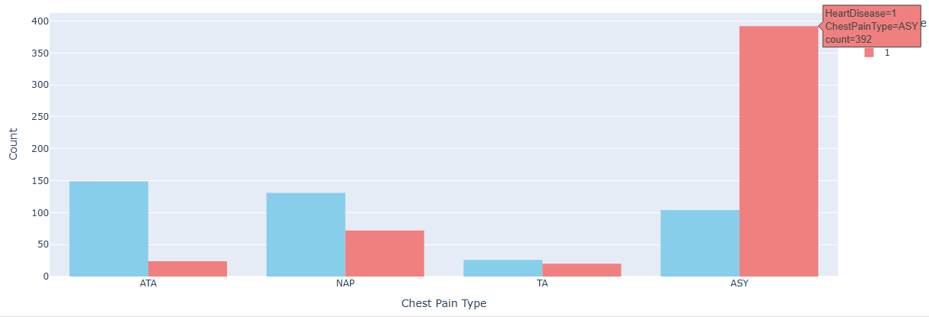
Features & Insights
CHEST PAIN TYPE VS HEART DISEASE

Slide 6
MACHINE LEARNING MODELS
Used multiple classification models:
Logistic Regression
Random Forest Classifier
Support Vector Machine (SVM)
Evaluation:
Accuracy
Recall
Cross-validation
Confusion matrix

Slide 7
STREAMLIT WEB APP
User Experience:
Input health parameters through UI
Get instant prediction result
Red warning if disease is predicted
Green success message if healthy

Slide 8
TOOLS & TECHNOLOGIES
Languages & Libraries:
Languages & Libraries:
Python, Pandas, NumPy
Scikit-learn
Seaborn, Matplotlib, Plotly
Streamlit for UI
Deployment: https://heart-failure-prediction-dashboard.streamlit.app

Slide 9
CONCLUSION
Delivered a complete ML pipeline with real-time prediction
Created engaging visualizations for data understanding
Built and deployed an interactive dashboard accessible online

Slide 10
THANK YOU!
QUESTIONS?
📩 GITHUB: GITHUB.COM/REHAMHASSAN1

